Slide 1
An Approach To Measure Quality among Multiple Alignments and Align Oxford Nanopore Single Molecule Sequence Reads
By
Faisal Ahmed
Reg. No.: 2011331047
Supervisor:
Biswapriyo Chakrabarty
Lecturer,
Dept. of CSE, SUST
Co-Advisor:
Md. Ruhul Amin Shajib
Assistant Professor,
Dept. of CSE, SUST

Slide 2
What is Sequence Alignment
Sequence alignment is a way to arrange several sequences of DNA or RNA to identify similar regions that may have consequences on relationships among the sequences.

Slide 3
Sequence Alignment
Global Alignment
Local Alignment

Slide 4
Our task on Sequence Alignment
Here we are working on finding similarity between a reference genome and some reads.

Slide 5
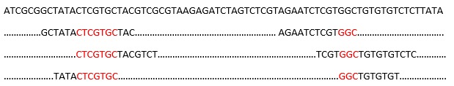
Reference Genome
Short Reads
Common Area Coverages

Slide 6
Sequence Alignment Mapping
Sequence Alignment Mapping (SAM) is a standard format to show how a tool makes alignment on several reads with any other genome reference.

Slide 7
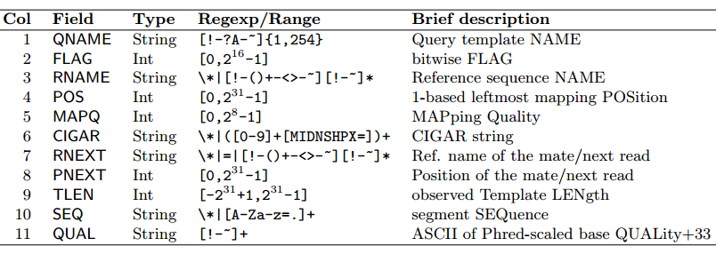
Sequence Alignment Mapping File Format Specifications

Slide 8
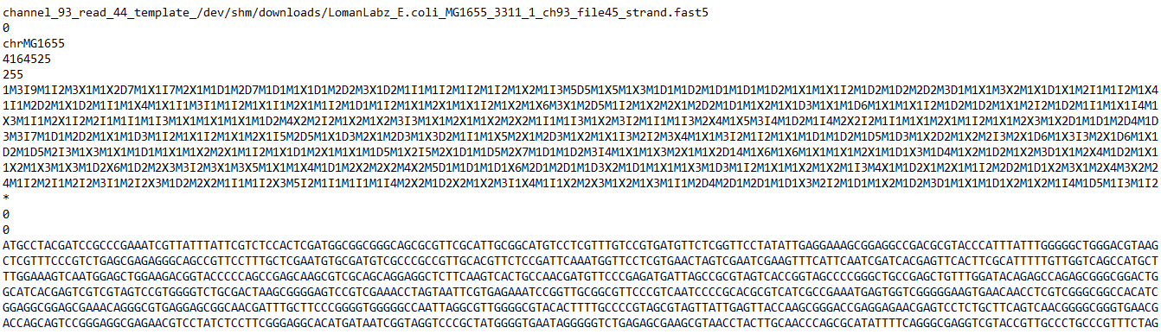

Slide 9
Tools To Evaluate SAM Files
Qualimap
Picard tools
RNA-SeQC
RSeQC

Slide 10
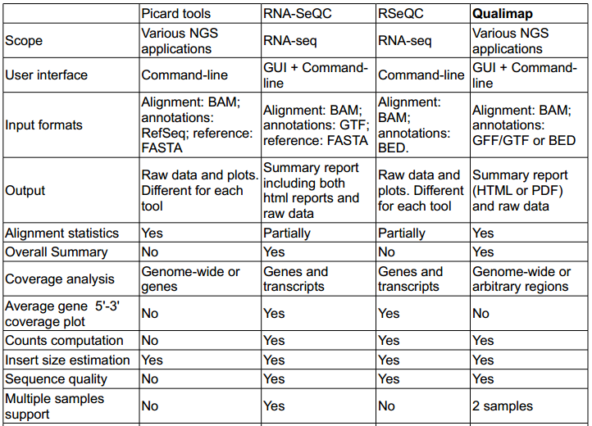

Slide 11
Analysis On NanoBLASTer
Evaluation of corresponding SAM file

Slide 12
Analysis On NanoBLASTer
Evaluation of corresponding SAM file
Analysis on results

Slide 13
Analysis On NanoBLASTer
Evaluation of corresponding SAM file
Analysis on results
Experimenting new method on tool’s used algorithm

Slide 14
Analysis On NanoBLASTer
Evaluation of corresponding SAM file
Analysis on results
Experimenting variations on tool’s used algorithm
Analysis results on experimental changes

Slide 15
Data Set
We took 1000 reads from Oxford Nanopore Single Molecule Reads with minimum 100 length and maximum of 1000 length.

Slide 16
Data Set
We took 1000 reads from Oxford Nanopore Single Molecule Reads with minimum 100 length and maximum of 1000 length.
Data Set is highly noisy.

Slide 17
Scale Measurement Definition
Percentage of Identity means Percentage of Matches considering all penalties (insertion, deletion, mismatches)

Slide 18
Scale Measurement Definition
Percentage of Identity means Percentage of Matches considering all penalties (insertion, deletion, mismatches)
POI = Total number of matches/ (Total Matches + Total Penalties)

Slide 19
Scale Measurement Definition
Counted-
Total Matches
Total Mismatches
Total Insertions
Total Deletions

Slide 20
Measuring Quality
Measured POI of sample data and compared with implemented alignment POI
If POI (from implemented alignment) > POI (from sample data) then quality falls otherwise it will be called better in this scale

Slide 21
Graph Plotting
X - axis is POI from 1 to 100
Y - axis is frequency of POIs’

Slide 22
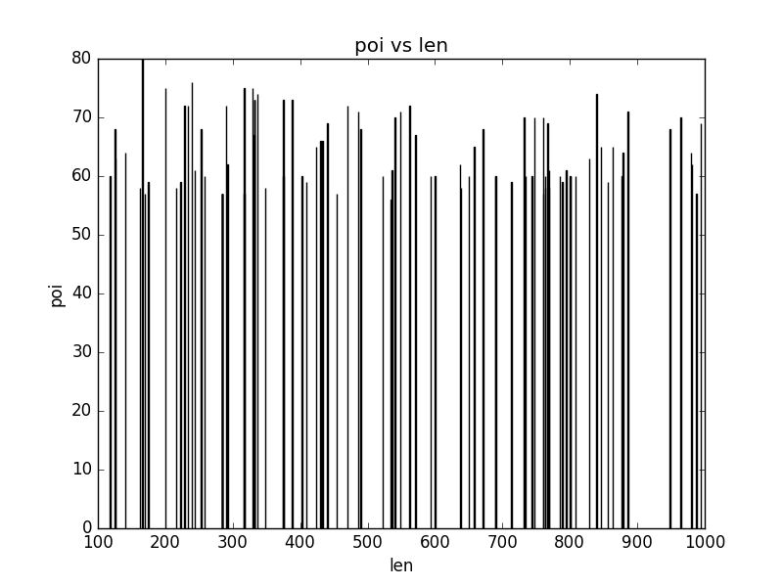
Max POI vs. Length

Slide 23
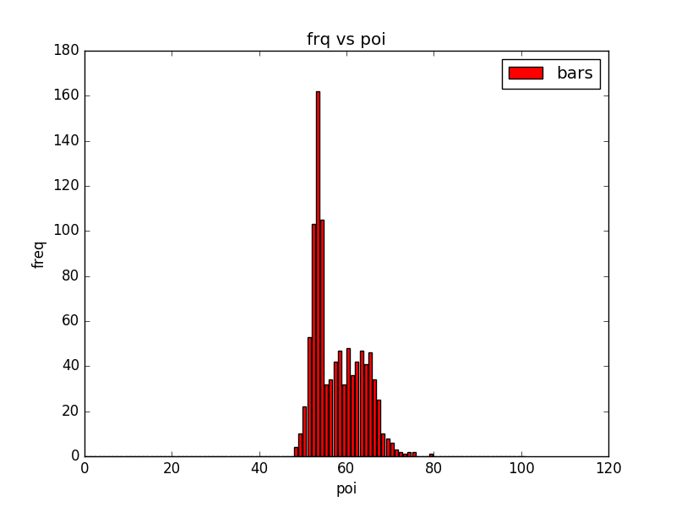
Frequency vs. POI (Global Alignment)

Slide 24
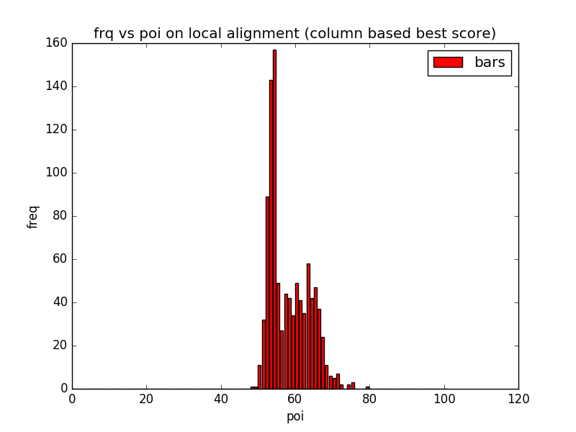
Local Alignment (Considering Column)

Slide 25
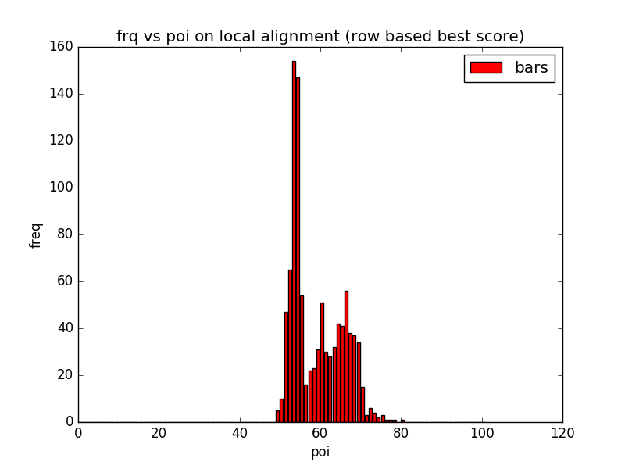
Local Alignment (Considering Row)

Slide 26
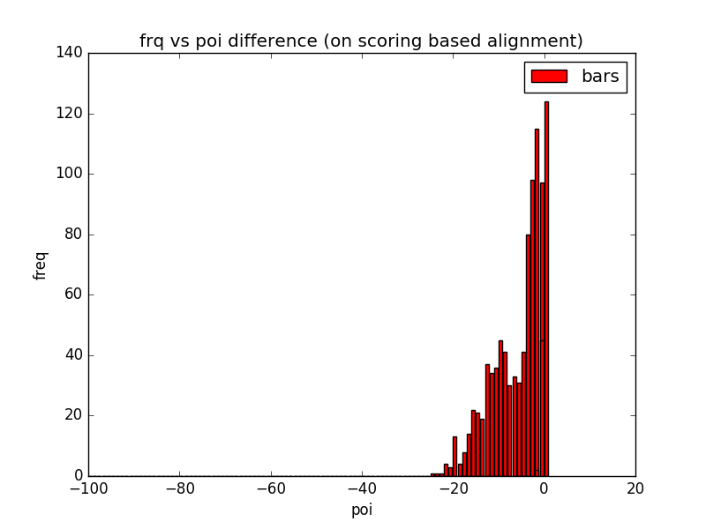
Difference with Implemented Global Alignment

Slide 27
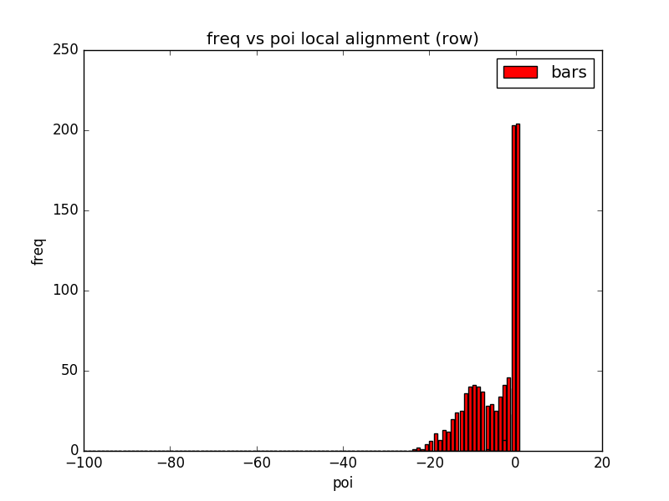
Difference with Implemented Local Alignment

Slide 28
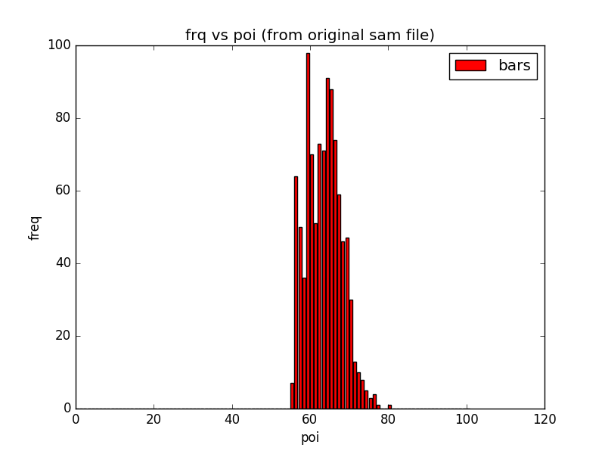
Freq. vs. POI (from original Input Data)

Slide 29
Experimented Method
Mapping reference genome into several K-mers

Slide 30
Experimented Method
Mapping reference genome into several K-mers
Mapping reads into several K-mers

Slide 31
Experimented Method
Mapping reference genome into several K-mers
Mapping reads into several K-mers
Preparing 2-D vector with the mapped values with matching considering threshold values.

Slide 32
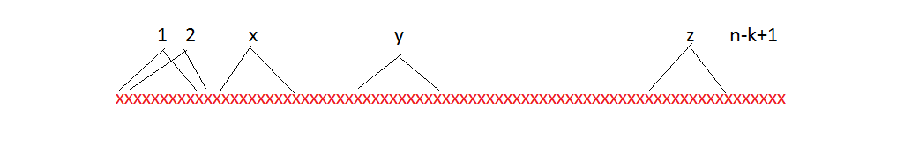
Mapping Reference Genome

Slide 33
Mapping Reference Genome
1 | xxxxxxx
2 | xxxxxxx
3 | xxxxxxx
4 | xxxxxxx
5 | xxxxxxx
n-k-1 | xxxxxxx
n-k | xxxxxxx
n-k+1 | xxxxxxx

Slide 34
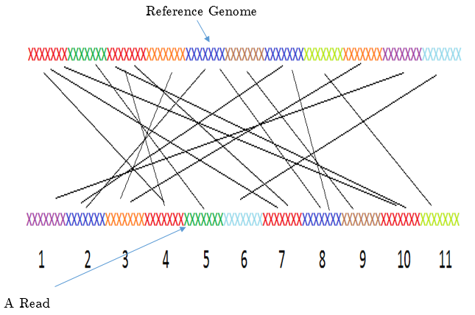
Preparing 2-D Vector

Slide 35
K-Mer starting positon from Reference Genome | K-Mer starting position from a Read
1 | 4
1 | 7
1 | 10
2 | 5
3 | 4
3 | 7
3 | 10
4 | 3
5 | 2
5 | 8
6 | 9
7 | 2
7 | 8
8 | 11
9 | 3
10 | 1
11 | 6

Slide 36
Result After Running Longest Increasing Subsequence Algorithm on the Vector
K-Mer starting positon from Reference Genome | K-Mer starting position from a Read
1 | 4
2 | 5
5 | 8
6 | 9
8 | 11

Slide 37
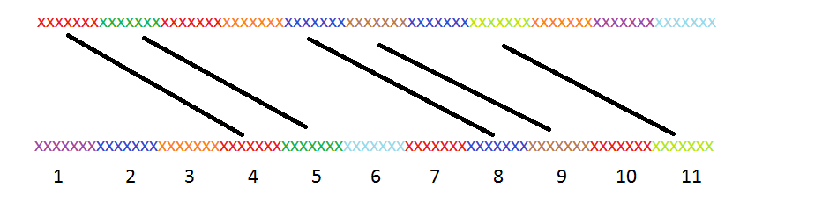
Visualizing LIS result

Slide 38
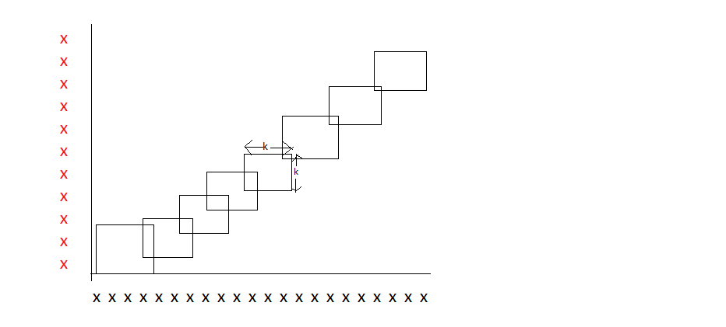
Block Alignment On Unaligned Areas

Slide 39
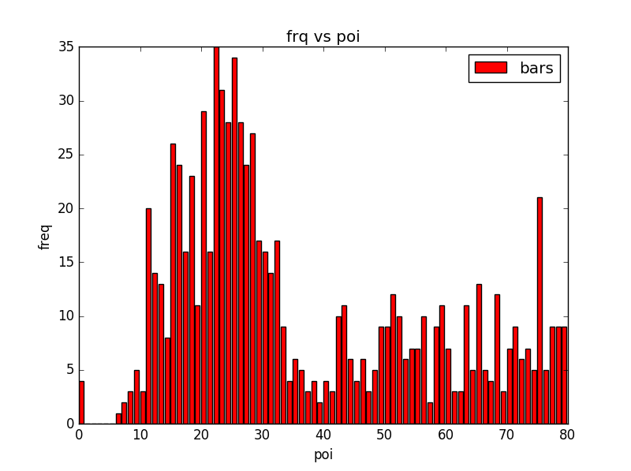
For k=11

Slide 40
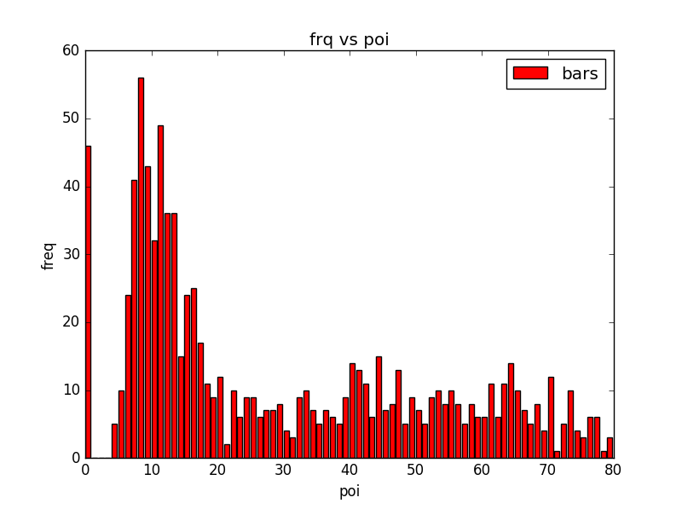
For k=12

Slide 41
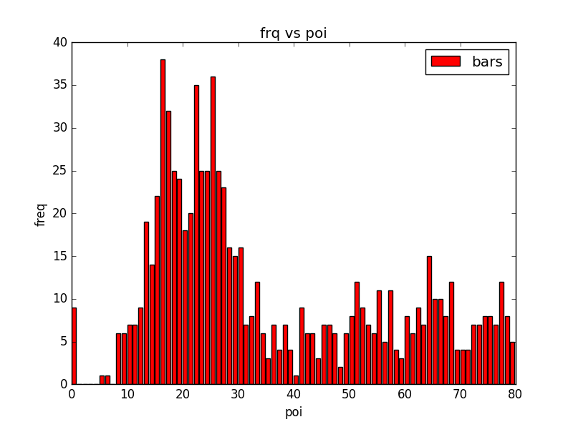
For k=13

Slide 42
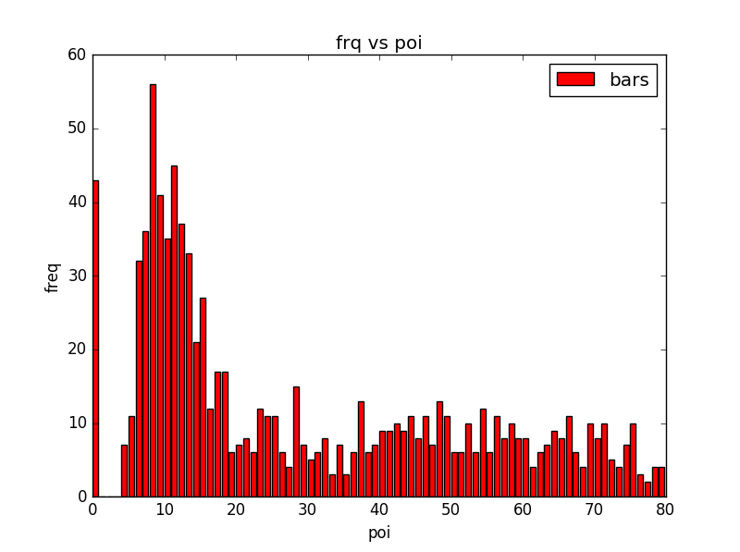
For k=14

Slide 43
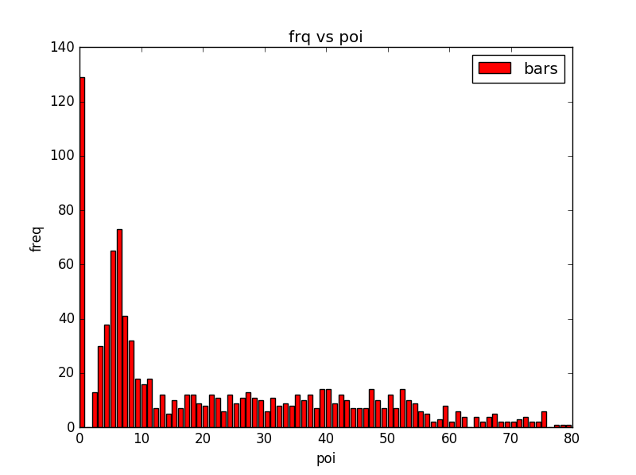
For k = 15

Slide 44
Observation
Result has been getting worse with incrementing values of k

Slide 45
Observation
Result has been getting worse with incrementing values of k
Best result got with k=11 and k=13

Slide 46
Questions…..

